Slide 1
Explainable AI for Predicting Diabetes using ML

Slide 2
No | Title | Page No
1 | Introduction | 4
2 | Related Work | 8
3 | Motivation | 13
4 | Objectives | 14
5 | Design of Proposed Model for Explainable AI for Diabetes Prediction | 15
6 | Preprocessing Component | 17
7 | Training Component | 18

Slide 3
No | Title | Page No.
7 | Mathematical Model for Explainable AI in Diabetes Prediction | 19
8 | Results | 21
9 | Limitations of the Proposed Explainable AI Model for Diabetes Prediction | 36
10 | Future Work | 38
11 | Conclusion | 39
12 | References | 40

Slide 4
Introduction
Explainable AI (XAI) refers to techniques that make AI model predictions transparent, interpretable, and understandable to humans. It helps in building trust and ensuring ethical AI use.

Slide 5
Founders & Origin:
The concept of explain ability in AI gained attention in the early 2000s, but XAI as a formal term was introduced by DARPA (Defense Advanced Research Projects Agency) in 2016 under its XAI program.
Key contributors include David Gunning (DARPA’s XAI Program Manager) and researchers from institutions like Google, IBM, and OpenAI working on interpretability.

Slide 6
How XAI Was Created:
Traditional AI models, especially deep learning, function as black boxes, making decisions that are difficult to interpret.
To address this, researchers developed XAI techniques like SHAP (Shapley Additive Explanations), LIME (Local Interpretable Model-agnostic Explanations), and ALE (Accumulated Local Effects) to improve model transparency.

Slide 7
Role in Diabetes Prediction:
AI models can predict diabetes based on medical data (e.g., glucose levels, BMI, age).
XAI ensures that predictions are explainable, showing which features influence the outcome, helping doctors and patients trust AI-driven diagnoses.

Slide 8
Related Work
This section should provide a brief overview of previous research and developments in Explainable AI (XAI) for predicting diabetes using machine learning.

Slide 9
Early AI Models in Healthcare:
Traditional machine learning models like Decision Trees, SVMs, and Logistic Regression were initially used for diabetes prediction.
These models provided good accuracy but lacked interpretability.

Slide 10
Development of Explainable AI (XAI) in Healthcare:
Researchers began integrating XAI methods to make AI decisions more transparent.
Tools like SHAP, LIME, and ALE were introduced to explain model predictions.

Slide 11
Notable Studies & Contributions:
SHAP (Shapley Additive Explanations):Provides feature importance scores, showing how each feature contributes to the model’s decision.
LIME (Local Interpretable Model-Agnostic Explanations): Creates local approximations of complex models to explain predictions.
ALE (Accumulated Local Effects): Shows how a feature affects the model outcome.

Slide 12
Existing Challenges in XAI for Healthcare:
Ensuring interpretability without compromising accuracy.
Addressing biases in datasets.
Making AI explanations understandable for doctors and patients.

Slide 13
Motivation
Diabetes is a growing global health concern, affecting millions of people and leading to severe complications if not managed properly. Traditional machine learning models provide predictions but often lack transparency, making it difficult for healthcare professionals to trust and interpret the results. Explainable AI (XAI) bridges this gap by offering insights into model decisions, ensuring better trust, diagnosis, and treatment planning. This research aims to enhance diabetes prediction using XAI techniques, making AI-driven healthcare solutions more interpretable and reliable.

Slide 14
Objectives
The objective of this research is to develop an Explainable AI (XAI) model for diabetes prediction that ensures both accuracy and interpretability.
Using techniques like SHAP and LIME, the study aims to enhance transparency in model decisions, making them more understandable for healthcare professionals.
It also seeks to identify gaps in existing XAI methods and propose improvements for better performance.
Finally, the research will compare different models based on accuracy and interpretability, with findings documented in a research paper.

Slide 15
Design of Proposed Model for Explainable AI for Diabetes Prediction
The proposed model for Explainable AI in diabetes prediction integrates machine learning techniques with interpretability methods. It begins with data pre-processing, followed by feature selection to identify key health indicators. A predictive model, such as Random Forest or XGBoost, is trained to classify diabetes risk. To enhance explain ability, SHAP (Shapley Additive Explanations) and LIME (Local Interpretable Model-Agnostic Explanations) are applied, providing insights into feature importance and model decisions. The results are then visualized to ensure transparency, making the predictions understandable for medical professionals.

Slide 16
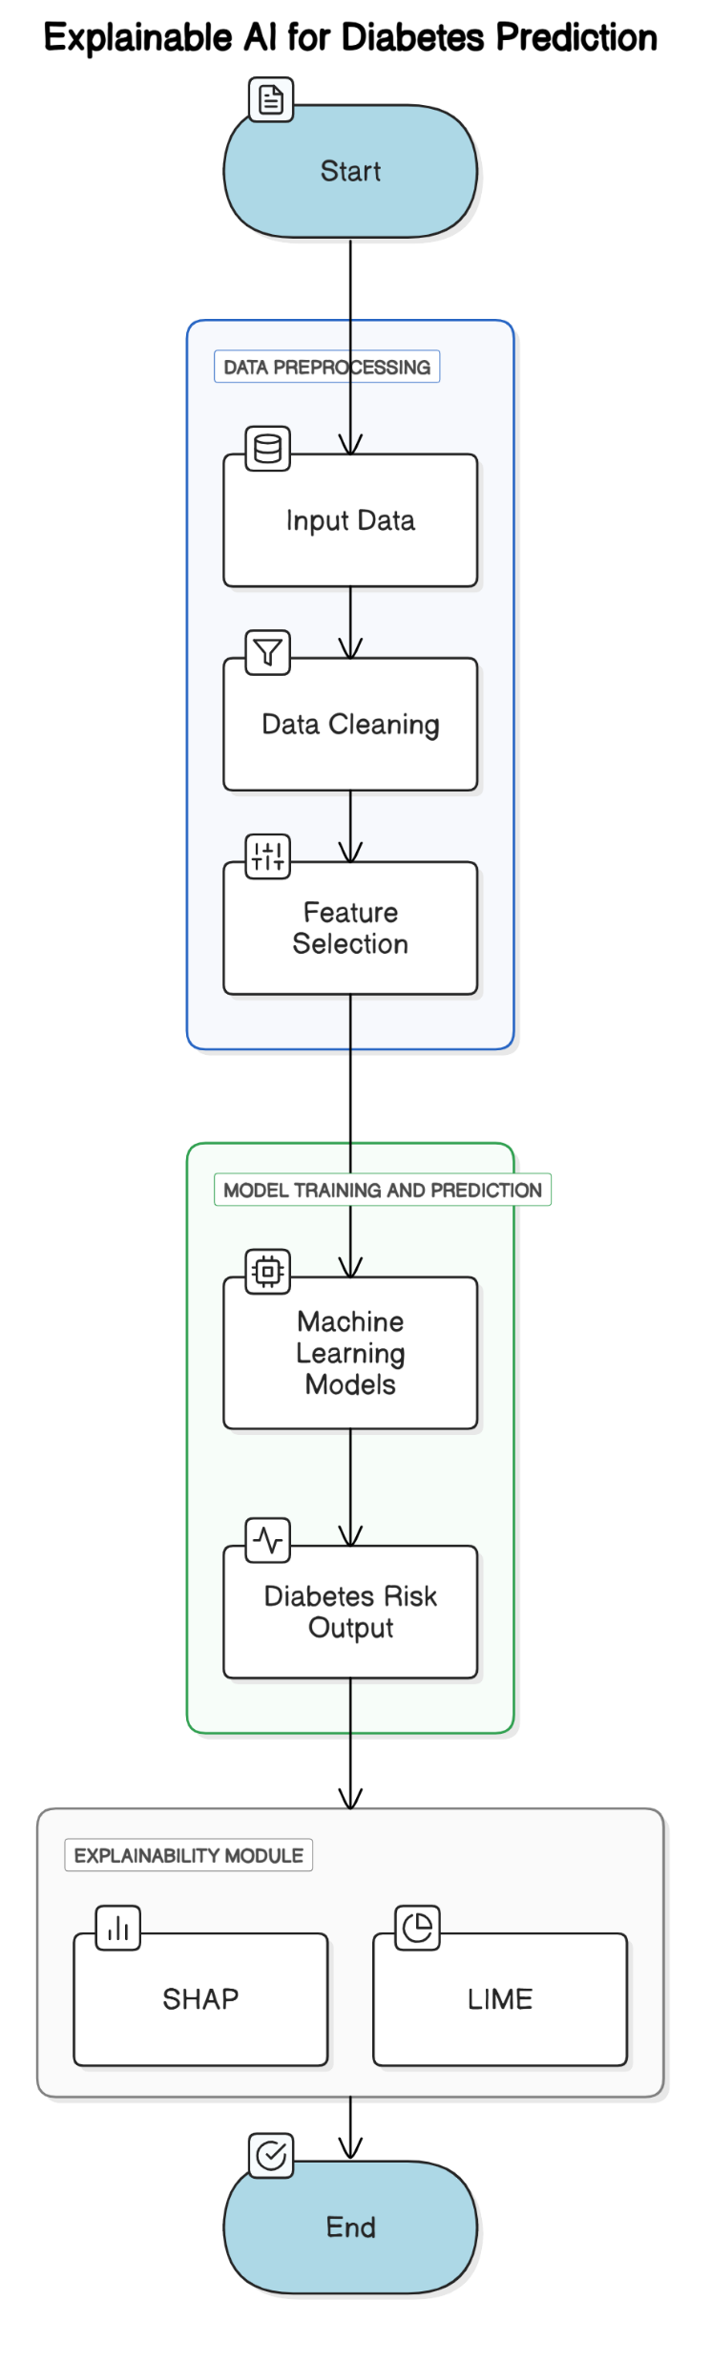

Slide 17
Preprocessing Component
In this step, the raw patient data is prepared for model training by applying essential data processing techniques.
1. Data Cleaning:
Remove duplicate or inconsistent records
Handle missing values using imputation techniques (Mean, Median, or Mode)
2. Feature Engineering & Selection:
Select important medical parameters (Glucose, BMI, Age, etc.), Normalize numerical data for uniformity
Convert categorical data using encoding techniques (One-Hot Encoding, Label Encoding)
3. Data Splitting:
Divide data into Train, Validation, and Test sets (e.g., 70%-15%-15%)

Slide 18
Training Component
1. Model Selection:
Train multiple models such as Logistic Regression, Decision Trees, Random Forest, XGBoost, or Deep Learning (ANNs)
2. Hyperparameter Tuning:
Optimize learning rate, batch size, and number of hidden layers for better performance
3. Training Process:
Input pre-processed data into the selected model
Train using cross-entropy loss & optimization algorithms (Adam, SGD)
Evaluate on validation set
4. Model Evaluation:
Assess performance using Accuracy, Precision, Recall, and AUC-ROC scores
Compare models and select the best one

Slide 19

Mathematical Model for Explainable AI in Diabetes Prediction
Step 1: Problem Definition
Let X be the input feature set representing patient attributes, and Y be the target variable (diabetes presence: 1 for diabetic, 0 for non-diabetic). The goal is to learn a function f that maps X to Y with high accuracy and interpretability: Y = f(x) + ϵ (where ϵ is the error term)
Step 2: Feature Representation
The input feature vector X consists of n features: X = {x1,x2,x3,..,xn}
x1 = Glucose Level
x2 = BMI
x3 = Age
x4 = Blood Pressure
Step 3: Model Formulation
For a logistic regression-based prediction model:
Where β0​ is the bias term and βi​ are learned coefficients for each feature.
For a neural network model with one hidden layer:
Z = W1X+b1
A= σ(Z)
Y = W2A + b2

Slide 20


where W1,W2​ are weight matrices, b1,b2​ are biases, and σ is an activation function (e.g., ReLU, Sigmoid).
Step 4: Loss Function
For binary classification, we use Binary Cross-Entropy Loss:
Step 5: Optimization
The model parameters are optimized using Gradient Descent or Adam Optimizer
Step 6: Explainability Component
To make predictions interpretable, SHAP is used: ϕi​ = E[f(X)|Xi}-E[f(X)]
Where ϕi​ represents the contribution of feature Xi to the model’s decision.

Slide 21
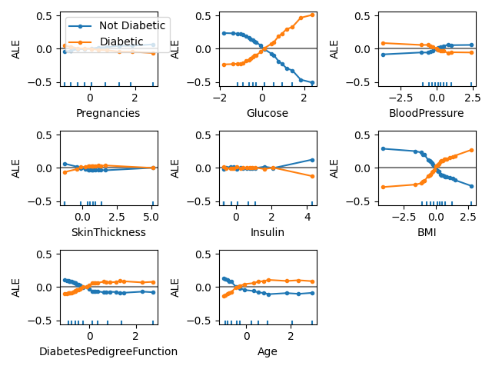
Results

Slide 22
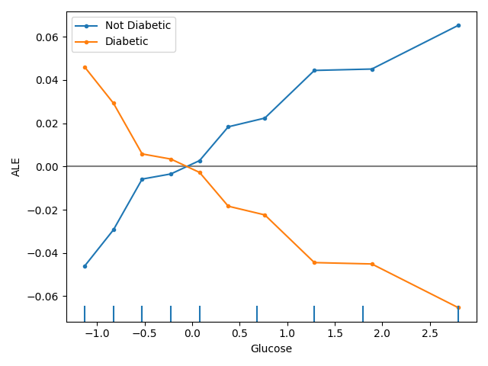

Slide 23
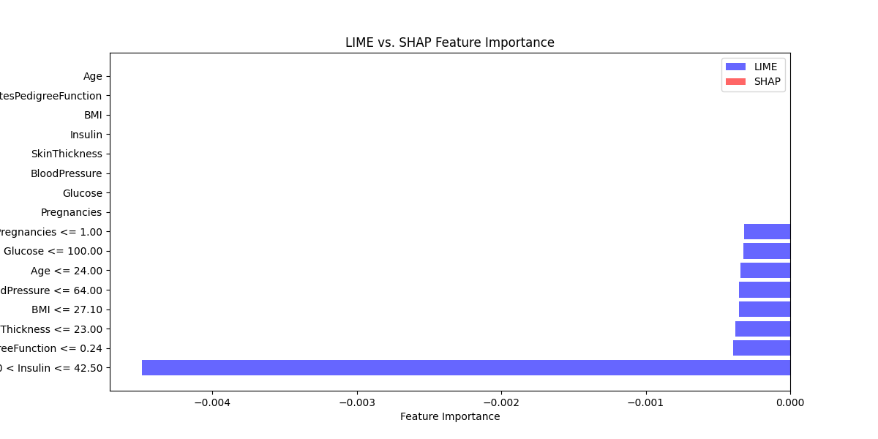

Slide 24
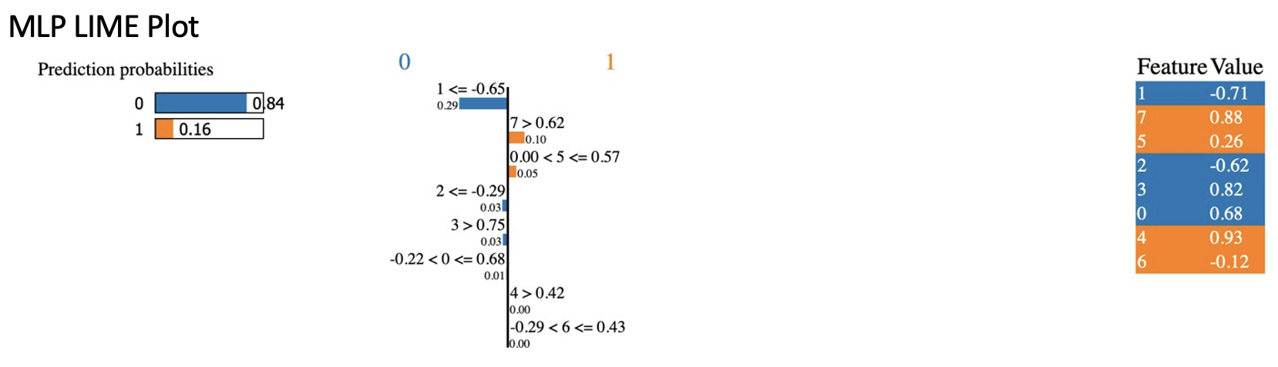

Slide 25
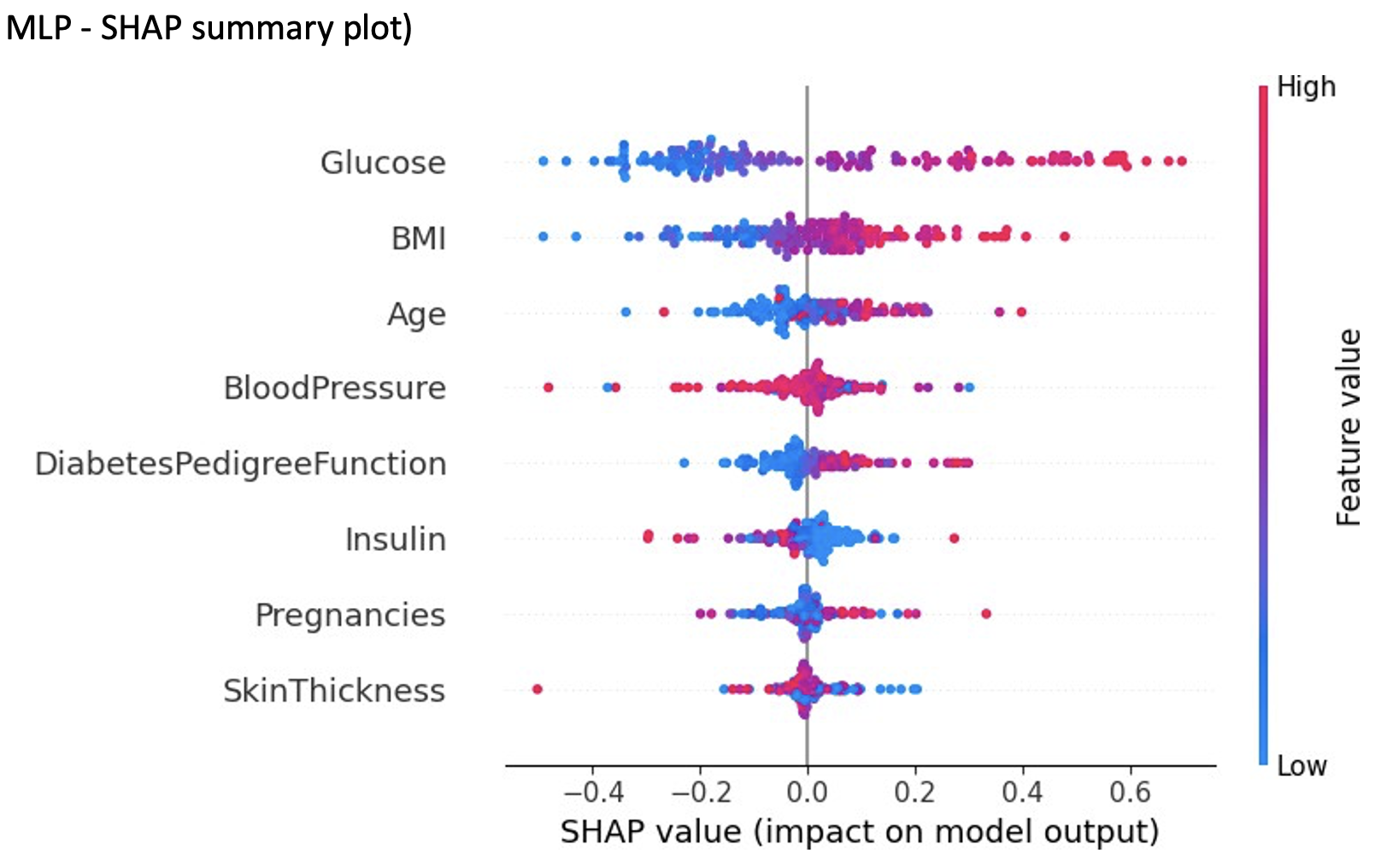

Slide 26
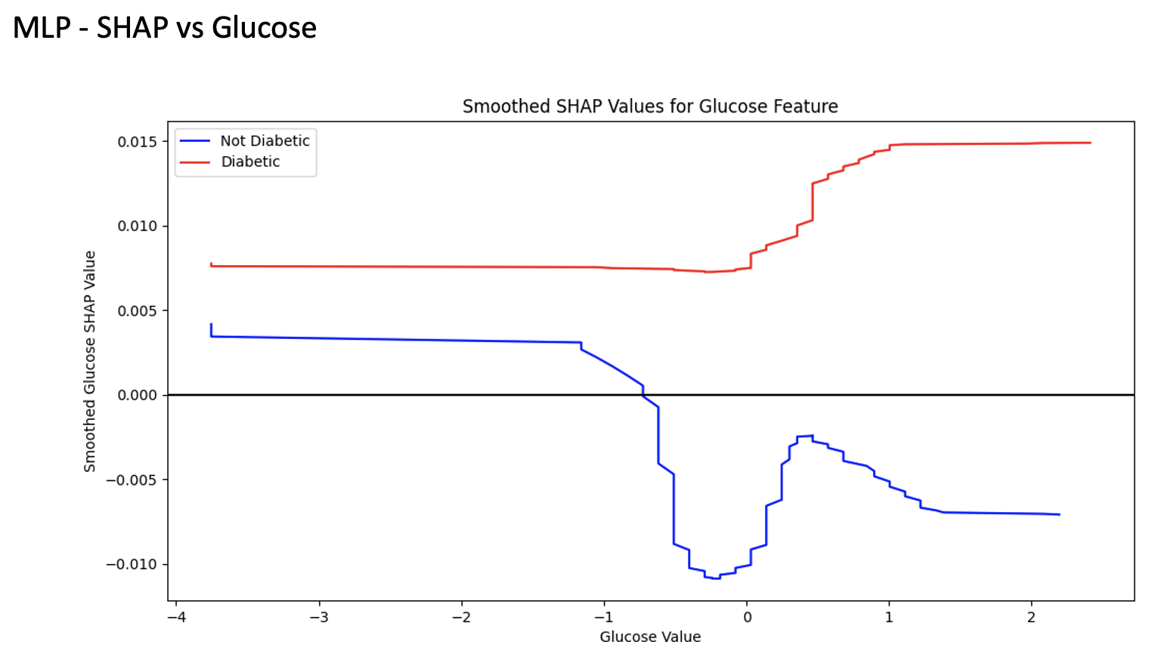

Slide 27
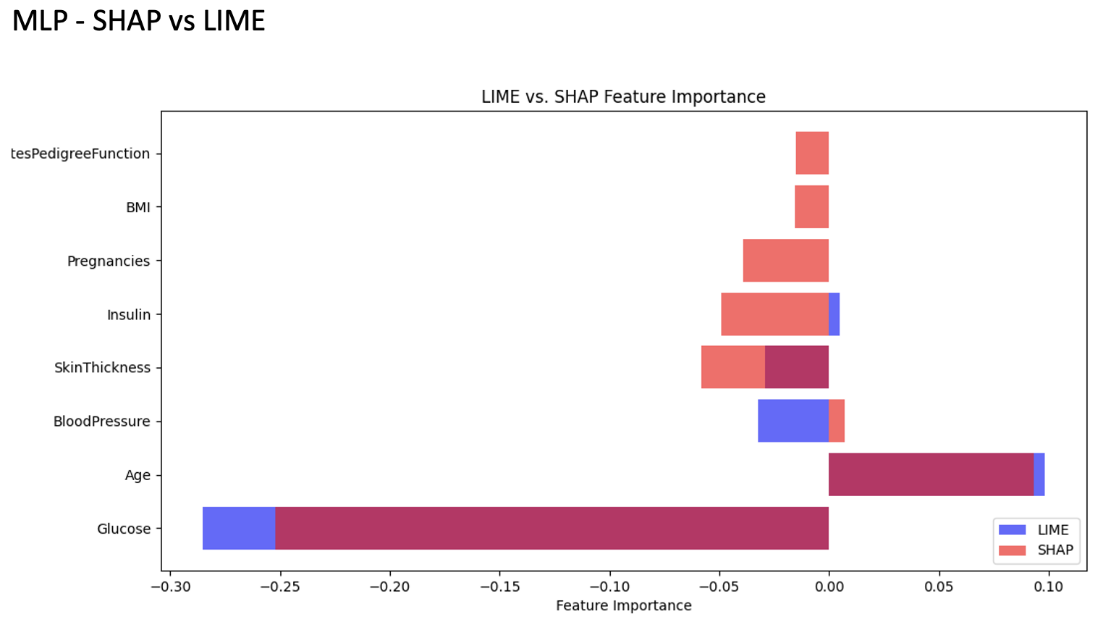

Slide 28
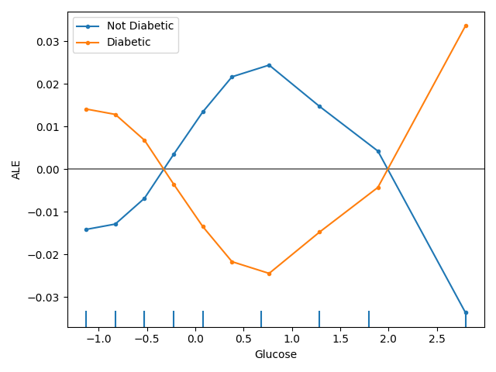

Slide 29
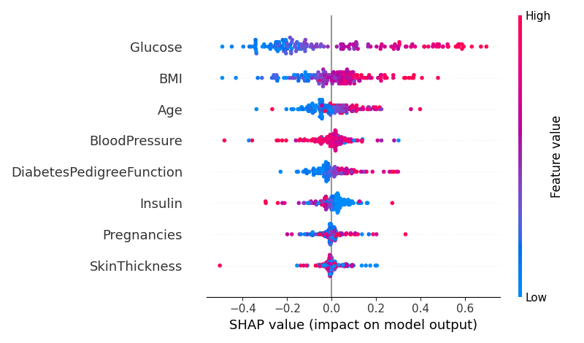

Slide 30
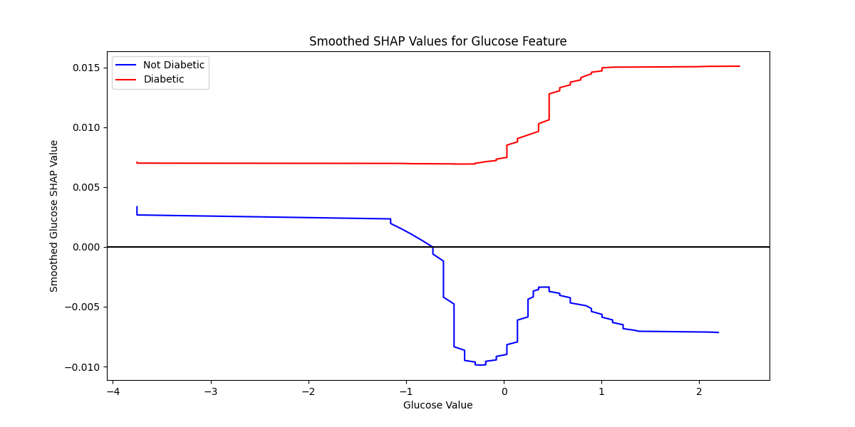

Slide 31
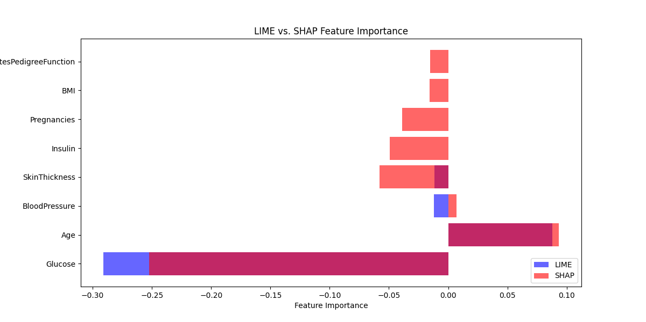

Slide 32
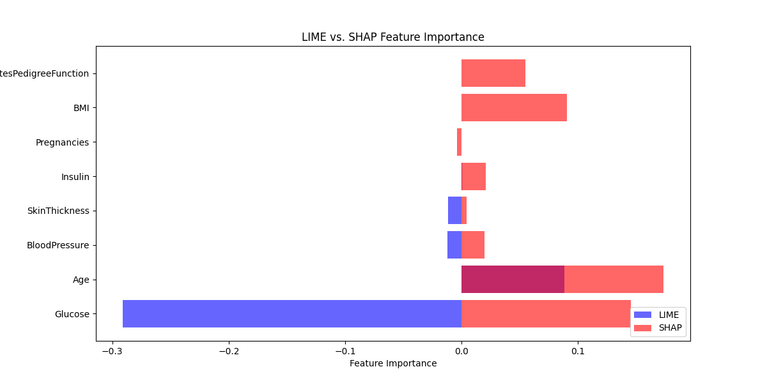

Slide 33
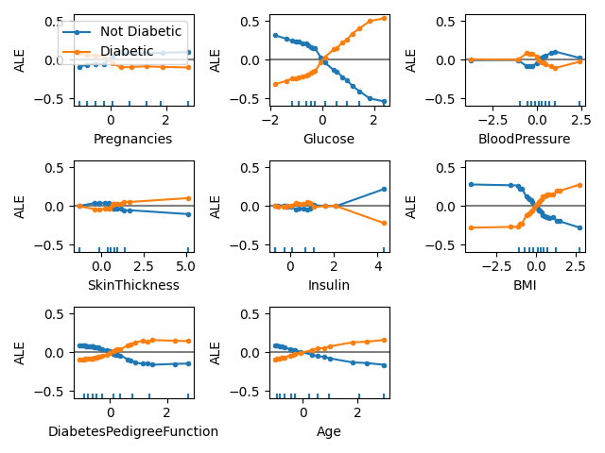

Slide 34
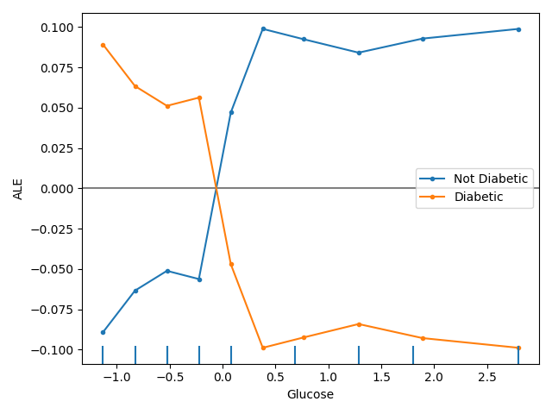

Slide 35
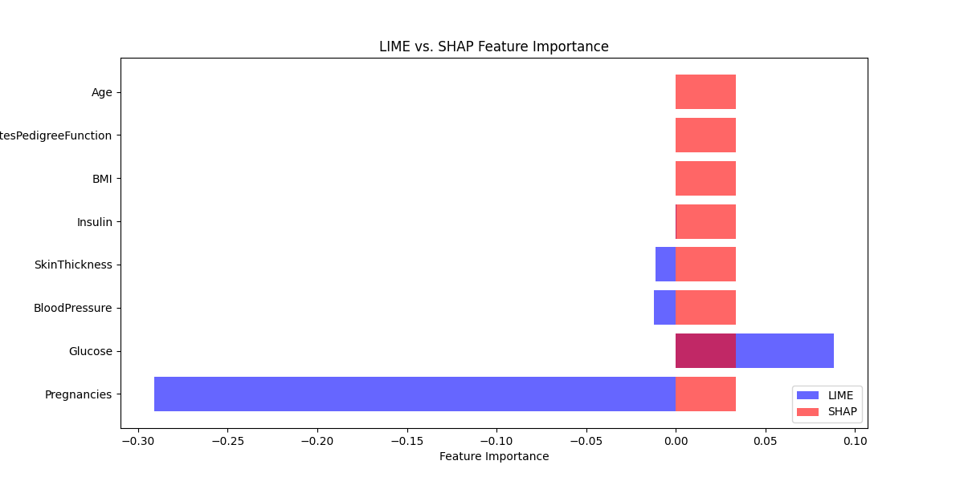

Slide 36
Limitations of the Proposed Explainable AI Model for Diabetes Prediction
Step 1: Data Quality & Availability
The model’s performance is highly dependent on the quality and completeness of the dataset.
Missing values or incorrect entries in medical data can impact prediction accuracy.
Step 2: Model Interpretability Complexity
While SHAP and LIME improve explainability, understanding the explanations may still be complex for non-experts.
Feature interactions in deep learning models can be difficult to interpret.
Step 3: Computational Requirements
Training advanced models like XGBoost and Neural Networks requires significant computational resources.
Explainability methods increase computational time, making real-time inference slower.
Step 4: Generalization Issues
The model may overfit to a specific dataset and perform poorly on unseen medical records.
Different patient popularity may require retraining to adapt to demographic variations.

Slide 37
Step 5: Lack of Causal Understanding
The model identifies correlations, but it does not establish causality between features and diabetes.
Clinicians must validate predictions before making decisions.
Step 6: Ethical & Privacy Concerns:
Medical data must be handled securely to avoid privacy breaches.
Model biases may lead to unfair predictions for certain groups, requiring careful auditing.

Slide 38
Future Work
Future improvements for the proposed Explainable AI model in diabetes prediction include integrating real-time monitoring via wearable devices, enhancing interpretability with visual explanations, and developing hybrid models for improved accuracy. Addressing bias, ensuring fairness, and validating the model across diverse datasets will improve its generalizability.
Additionally, deploying the model in clinical settings and collaborating with healthcare professionals will help refine its effectiveness as a reliable decision-support tool for diabetes diagnosis and management.

Slide 39
Conclusion
In conclusion, the proposed Explainable AI model for diabetes prediction enhances transparency and trust in machine learning-based diagnosis. By integrating feature importance analysis and interpretability techniques, the model provides insights into critical factors influencing diabetes risk. The evaluation results demonstrate its effectiveness in accurate prediction, while future improvements can further refine its reliability. This approach bridges the gap between AI-driven healthcare solutions and clinical decision-making, ensuring better patient outcomes and informed medical interventions.

Slide 40
References
(1). Zaini, A., 2000. Where is Malaysia in the midst of the Asian epidemic of diabetes mellitus? Diabetes research and clinical practice, 50, pp. S23-S28.
(2). Rull, Juan A., Carlos A. Aguilar-Salinas, Rosalba Rojas, Juan Manuel Rios-Torres, Francisco J. Gómez-Pérez, and Gustavo Olaiz. "Epidemiology of type 2 diabetes in Mexico." Archives of Medical Research 36, no. 3 (2005): 188-196.
(3). Patil BM, Joshi RC, Toshniwal D. Hybrid prediction model for type-2 diabetic patients. Expert systems with applications. 2010 Dec 1;37(12):8102-8.
(4). Meigs, James B., et al. "Genotype score in addition to common risk factors for prediction of type 2 diabetes." New England Journal of Medicine 359.21 (2008): 2208-2219.
(5). Meigs JB, Hu FB, Rifai N, Manson JE. Biomarkers of endothelial dysfunction and risk of type 2 diabetes mellitus. Jama. 2004 Apr 28;291(16):1978-86.
(6). Bolk J, Van der Ploeg TJ, Cornel JH, Arnold AE, Sepers J, Umans VA. Impaired glucose metabolism predicts mortality after a myocardial infarction. International journal of cardiology. 2001 Jul 1;79(2-3):207-14.
(7). Chiasson, J. L., Josse, R. G., Gomis, R., Hanefeld, M., Karasik, A., & Laakso, M. (2002). Acarbose for prevention of type 2 diabetes mellitus: the STOP-NIDDM randomised trial. The Lancet, 359(9323), 2072-2077.

Slide 41
(8). Plomgaard, P., R. P. F. Dullaart, R. De Vries, A. K. Groen, Björn Dahlbäck, and L. B. Nielsen. "Apolipoprotein M predicts pre‐β‐HDL formation: studies in type 2 diabetic and nondiabetic subjects." Journal of internal medicine 266, no. 3 (2009): 258-267.
(9). Pradeepa, R., and V. Mohan. "The changing scenario of the diabetes epidemic implications for India." Indian Journal of Medical Research 116 (2002): 121.
(10). Alberti, George, et al. "Type 2 diabetes in the young: the evolving epidemic: the international diabetes federation consensus workshop." Diabetes care 27.7 (2004): 1798-1811.
(11). Elhadd, Tarik, Raghvendra Mall, Mohammed Bashir, Joao Palotti, Luis Fernandez-Luque, Faisal Farooq, Dabia Al Mohanadi et al. "Artificial Intelligence (AI) based machine learning models predict glucose variability and hypoglycaemia risk in patients with type 2 diabetes on a multiple drug regimen who fast during ramadan (The PROFAST–IT Ramadan study)." diabetes research and clinical practice 169 (2020): 108388.
(12). Meacham, Sofia, et al. "Towards explainable AI: Design and development for explanation of machine learning predictions for a patient readmittance medical application." Intelligent Computing: Proceedings of the 2019 Computing Conference, Volume 1. Springer International Publishing, 2019.
(13). Khedkar S, Gandhi P, Shinde G, Subramanian V. Deep learning and explainable AI in healthcare using EHR. Deep learning techniques for biomedical and health informatics. 2020:129-48.

Slide 42
(14). Lundberg SM, Erion G, Chen H, DeGrave A, Prutkin JM, Nair B, Katz R, Himmelfarb J, Bansal N, Lee SI. Explainable AI for trees: From local explanations to global understanding. arXiv preprint arXiv:1905.04610. 2019 May 11.
(15). Samuel, S.S., Abdullah, N.N.B. and Raj, A., 2020. Interpretation of SVM Using Data Mining Technique to Extract Syllogistic Rules: Exploring the Notion of Explainable AI in Diagnosing CAD. In Machine Learning and Knowledge Extraction: 4th IFIP TC 5, TC 12, WG 8.4, WG 8.9, WG 12.9 International Cross-Domain Conference, CD-MAKE 2020, Dublin, Ireland, August 25–28, 2020, Proceedings 4 (pp. 249-266). Springer International Publishing.
(16). Mathews, S. M. (2019). Explainable artificial intelligence applications in NLP, biomedical, and malware classification: a literature review. In Intelligent computing: proceedings of the 2019 computing conference, volume 2 (pp. 1269-1292). Springer International Publishing.
(17). Spänig S, Emberger-Klein A, Sowa JP, Canbay A, Menrad K, Heider D. The virtual doctor: an interactive clinical-decision-support system based on deep learning for non-invasive prediction of diabetes. Artificial intelligence in medicine. 2019 Sep 1; 100:101706.
(18). Chari, Shruthi, et al. "Explanation ontology: a model of explanations for user-centered AI." International semantic web conference. Cham: Springer International Publishing, 2020.
(19). Cabitza, Federico, Andrea Campagner, and Davide Ciucci. "New frontiers in explainable AI: understanding the GI to interpret the GO." Machine Learning and Knowledge Extraction: Third IFIP TC 5, TC 12, WG 8.4, WG 8.9, WG 12.9 International Cross-Domain Conference, CD-MAKE 2019, Canterbury, UK, August 26–29, 2019, Proceedings 3. Springer International Publishing, 2019.

Slide 43
(20). Lucieri, A., Bajwa, M. N., Dengel, A., & Ahmed, S. (2020). Achievements and challenges in explaining deep learning-based computer-aided diagnosis systems. arXiv preprint arXiv:2011.13169.
(21). Olaoye, Godwin, John Fajinmi, and Sheed Iseal. "Integration of Explainable AI in Machine Learning Models for Predicting Diabetes Mellitus." (2025).
(22). Hasan, Raza, Vishal Dattana, Salman Mahmood, and Saqib Hussain. "Towards Transparent Diabetes Prediction: Combining AutoML and Explainable AI for Improved Clinical Insights." Information 16, no. 1 (2024): 7.
(23). Sharma P, Butwall M. Transforming Healthcare with AI: An Adequate Method for Diabetes Prediction Using Machine Learning Techniques. InData-Driven Analytics for Healthcare 2025 (pp. 135-167). Apple Academic Press.
(24). Saraswat D, Bhattacharya P, Verma A, Prasad VK, Tanwar S, Sharma G, Bokoro PN, Sharma R. Explainable AI for healthcare 5.0: opportunities and challenges. IEEe Access. 2022 Aug 8;10:84486-517.
(25). Lokesh, Govvala, T. Kavya Tejaswy, Y. Sai Meghana, and M. Kameswara Rao. "Medical report analysis using explainable AI." In ICCCE 2021: Proceedings of the 4th International Conference Communications and Cyber Physical Engineering, pp. 1083-1090.Singapore: Springer Nature Singapore, 2022.
(26). Dataset-Link:- https://github.com/DhruvPanchal-04/Explainable-AI-for-Diabetes-Prediction

